Slide 1
University American College Skopje
Course: Computer Applications 1
Operating System
Marija Stanojeska, PhD

Slide 2
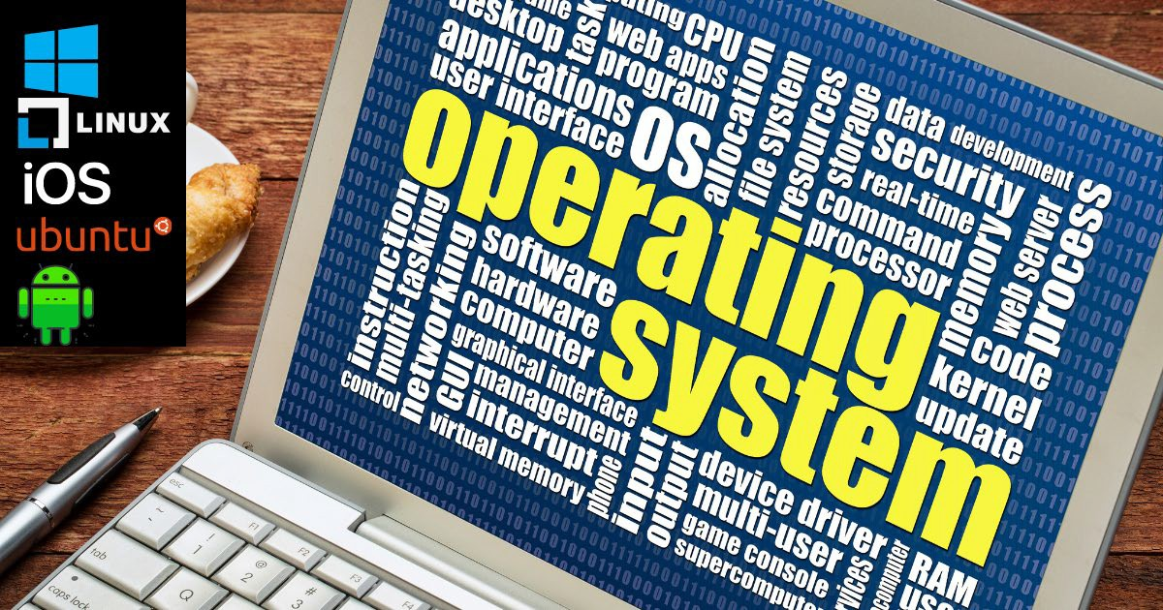
Based on the textbook:
Microsoft Office Inside Out (Office 2021 and Microsoft 365), J. Habraken, Pearson Education, Inc., 2022.

Slide 3
Lecture overview
Description of the basics of the Operating System.
Presentation of the history of Operating System.
Discussion of the functions of Operating System.
Explanation of Operating System.
Presentation of the most popular Operating System.
Description of virtual Operating System.
Discussion of the advantages and disadvantages of Operating System.

Slide 4
What is an Operating System?
The operating system is the most important program that runs on a computer.
Computer System = Hardware + Software
Software = Application Software + System Software (OS)
An Operating System is a system Software that acts as an interface between a user of a computer and the computer hardware.
Operating system goals:
Execute user programs and make solving user problems easier;
Make the computer system convenient to use;
Use the computer hardware in an efficient manner.

Slide 5
History of Operating System
The First Generation (1940's to early 1950's)
No Operating System.
All programming was done in absolute machine language, often by wiring up plug-boards to control the machine’s basic functions.
The Second Generation (1955-1965)
First operating system was introduced in the early 1950's. It was called GMOS.
Created by General Motors for IBM's machine.
The Third Generation (1965-1980)
Introduction of multiprogramming.
Development of Minicomputer.
The Fourth Generation (1980-Present Day)
Development of PCs.
Birth of Windows/ MaC OS.

Slide 6
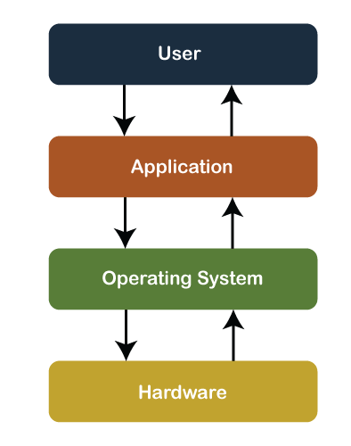
The Structure of Computer Systems
Accessing computer resources is divided into layers.
Each layer is isolated and only interacts directly with the layer below or above it.
If user install a new software application:
User will need to learn how to use the new application.
No need to make any changes to your hardware.
But user will need to make sure the application is supported by the operating system.
If user change the operating system:
Need to make sure that both applications and hardware will compatible with the new operating system.
If user install a new hardware device:
No need to change anything about the user/applications.
But user will need to make changes to the operating system.
User will need to install the device drivers that the operating system will use to control the new device.

Slide 7





Functions of Operating System
Process Management
User Interface
Memory Management
Operating System Function
Security and protection
File Management
I/O Management

Slide 8
Functions of Operating System
Process Management
A process is a program in execution.
A process needs certain resources, including central processing unit (CPU) time, memory, files, and input/output (I/O) devices to accomplish its task.
Simultaneous execution leads to multiple processes. Creation, execution and termination of a process are the most basic functionality of an OS.
If processes are dependent, than they may try to share same resources, thus task of process synchronization comes to the picture.
If processes are independent, than a due care needs to be taken to avoid their overlapping in memory area.
Based on priority, it is important to allow more important processes to execute first than others.

Slide 9
Functions of Operating System
Memory Management
Memory is a large array of words or bytes, each with its own address.
It is a repository of quickly accessible data shared by the CPU and I/O devices.
Main memory is a volatile storage device. When the computer made turn off everything stored in RAM will be erased automatically.
In addition to the physical RAM installed in your computer, most modern operating systems allow your computer to use a virtual memory system. Virtual memory allows your computer to use part of a permanent storage device (such as a hard disk) as extra memory.
The operating system is responsible for the following activities in connections with memory management:
Keep track of which parts of memory are currently being used and by whom.
Decide which processes to load when memory space becomes available.
Allocate and de-allocate memory space as needed.

Slide 10
Functions of Operating System
File Management
A file is a collection of related information defined by its creator.
File systems provide the conventions for the encoding, storage and management of data on a storage device such as a hard disk.
FAT12 (floppy disks)
FAT16 (DOS and older versions of Windows)
FAT32 (older versions of Windows)
NTFS (newer versions of Windows)
EXT3 (Unix/Linux)
HFS+ (Max OS X)
The operating system is responsible for the following activities in connections with file management:
  File creation and deletion.
  Directory creation and deletion.
  Support of primitives for manipulating files and directories.
  Mapping files onto secondary storage.
  File backup on stable (nonvolatile) storage media.

Slide 11
Functions of Operating System
Device or I/O Management
Device drivers, which are the operating system software components that interact with the devices controllers.
It performs the following activities for device management.
Keeps tracks of all devices connected to system.
Designates a program responsible for every device known as input/output controller.
Decides which process gets access to a certain device and for how long.
Allocates devices in an effective and efficient way.
Deallocates devices when they are no longer required.

Slide 12
Functions of Operating System
Security & Protection
The operating system uses password protection to protect user data and similar other techniques.
It also prevents unauthorized access to programs and user data by assigning access right permission to files and directories.
The owners of information stored in a multiuser or networked computer system may want to control use of that information, concurrent processes should not interfere with each other.

Slide 13
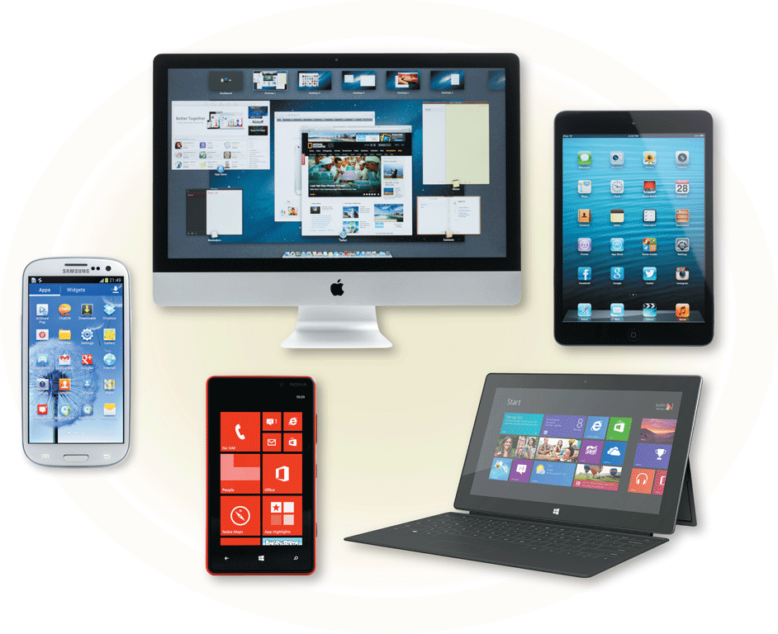
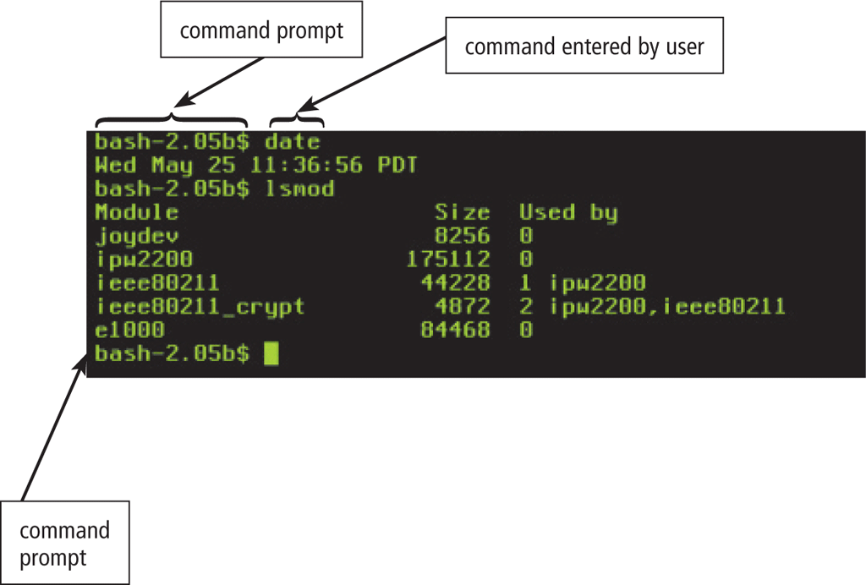
Functions of Operating System
User Interface Mechanism
A user interface (UI) controls how you enter data and instructions and how information is displayed on the screen.
1) Command Line Interface - a user types commands represented by short keywords or abbreviations or presses special keys on the keyboard to enter data and instructions.
2) Graphical user interface – a user interact with menus and visual images.

Slide 14
Types of Operating Systems
Batch Operating System
Multiprogramming Operating System
Time-Sharing OS
Multiprocessing OS
Distributed OS
Network OS
Real Time OS
Embedded OS

Slide 15

The most popular OS

Slide 16
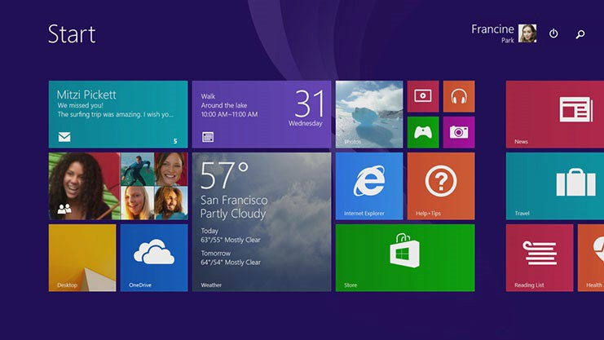
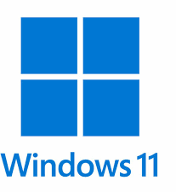
Microsoft Windows
Microsoft Windows is a computer operating system developed by Microsoft. It was first launched in 1985 as a graphical operating system built on MS-DOS.
The initial version was followed by several subsequent releases, and by the early 1990s, the Windows line had split into two separate lines of releases:
Windows 9x for consumers and Windows NT for businesses and enterprises. In the following years, several further variants of Windows would be released:
Windows CE in 1996 for embedded systems;
Pocket PC in 2000 (renamed to Windows Mobile in 2003 and Windows Phone in 2010) for personal digital assistants and, later, smartphones;
Windows Holographic in 2016 for AR/VR headsets; and several other editions.
Windows 11 is the latest major release of Microsoft's Windows NT operating system, released on October 5, 2021.

Slide 17
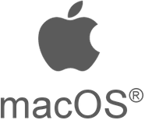
Apple Mac OS
Head-to-head in the competition with Microsoft Windows is Apple’s macOS. macOS and Windows are both examples of proprietary operating systems, meaning that the company conceptualized, designed, developed, and now sells their own OS.
Apple and Macintosh computers run on the proprietary macOS and OS X system, the first of which launched 20 years ago. There are also previous versions or updates which include:
  Kodiak (OS X 10 Beta)
  Lion (OS X 10.7)
  Mountain Lion (OS X 10.8)
  Mavericks (OS X 10.9)
  Yosemite (OS X 10.10)
  El Capitan (OS X 10.11)
  Sierra (macOS 10.12)
  High Sierra (macOS 10.13)
  Mojave (macOS 10.14)
  Catalina (macOS 10.15)
  BigSur (macOS 11)

Slide 18
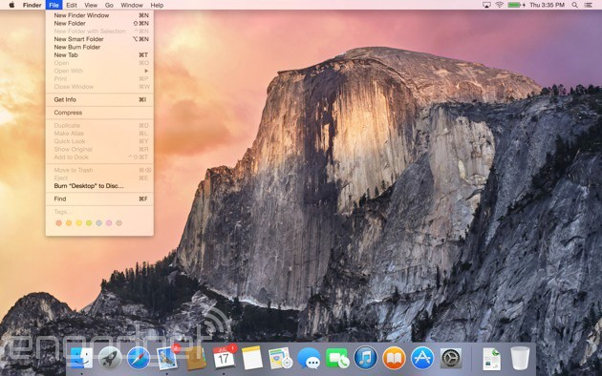
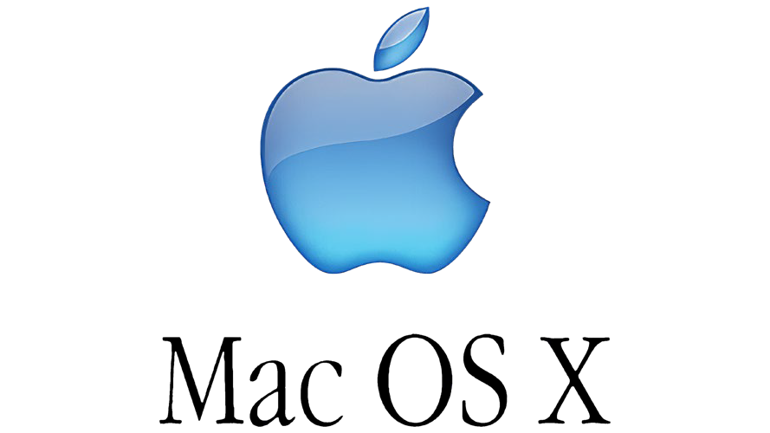
Apple Mac OS (cont.)
The macOS and Apple/Mac products are also known and beloved by their users for ease of use and continually improving user experience. Fast processing speeds, a simple desktop interface, and a wide variety of helpful resources make users excited about macOS.

Slide 19
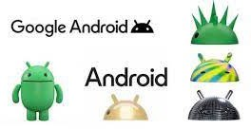
Google’s Android OS
The OS that companies including Google use to run its Android mobile smartphones and tablets is based on Linux distribution and other open source software. Android OS is the primary OS for Google mobile devices like smartphones and tablets. Android has gained increasing popularity since its release as an alternative to Apple’s iOS for smartphone users and is continuing to increase in popularity with new updates and exciting features.

Slide 20
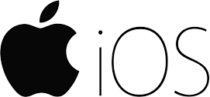
Apple IOS
It is another mobile operating system used exclusively for iPhones, some of the most popular mobile devices on the market. iOS integrations have regular updates, new expansions to software, and continually are offering new features for users even if they have older devices.
This operating system also allows other Apple devices to connect, giving users easy connections to other devices or people.

Slide 21
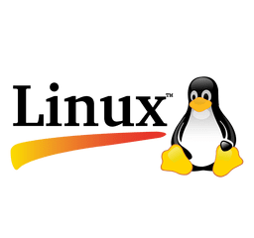
Linux
Linux is different from Windows and Apple in that it’s not a proprietary software, but rather a family of open source systems. In other words, anyone can modify and distribute it.
Linux is popular because of its ease of customization and offers a variety of options to those who understand how to use

Slide 22
Mobile vs. Computer OS
Why are there different types of operating systems for mobile tech and computers?
There are several reasons a single system doesn’t work perfectly for both. Computer and mobile OSs are different because they’re developed for different uses.
Computer systems have to store lots of complex data, have a different user interface, and need to be prepared for printing, removable disks, and more. They feature a desktop and a control panel for users to manage all of their information. Computer operating systems are also older, and therefore more familiar to the IT industry; they’ve been around much longer than phones that utilize operating systems.
Mobile phones don't feature a desktop that's the same as a computer desktop. Their user interface is much more about simple moves - things you can do with your fingers or voice - so it’s designed to offer a simpler interface. There are many resources to help users learn more about operating mobile phone systems, as they're very different from computer systems.

Slide 23

Homework
Explore the strengthens and weaknesses of Google Android OS and Apple IOS using:
The available internet sources (including the sources of information as http://...);
ChatGPT;
The researched results should be written on 2 pages.
Present the findings in open-class discussion.

Slide 24
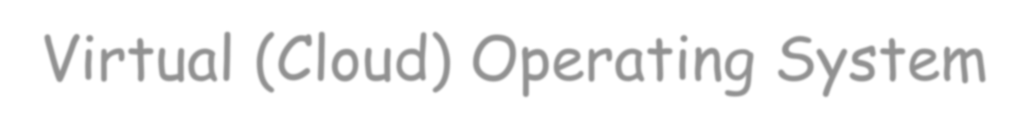
Virtual (Cloud) Operating System

Slide 25

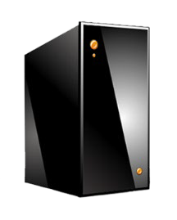
Cloud Operating System
A cloud operating system is a type of operating system designed to operate within cloud computing and virtualization environments. A cloud operating system may also be called a virtual operating system.
A cloud operating system manages the operation, execution and processes of virtual machines, virtual servers and virtual infrastructure, as well as the back-end hardware and software resources.
Cloud computing is the delivery of different services through the Internet. These resources include tools and applications like data storage, servers, databases, networking, and software. Cloud servers are located in data centers all over the world. By using cloud computing, users and companies do not have to manage physical servers themselves or run software applications on their own machines.

Slide 26
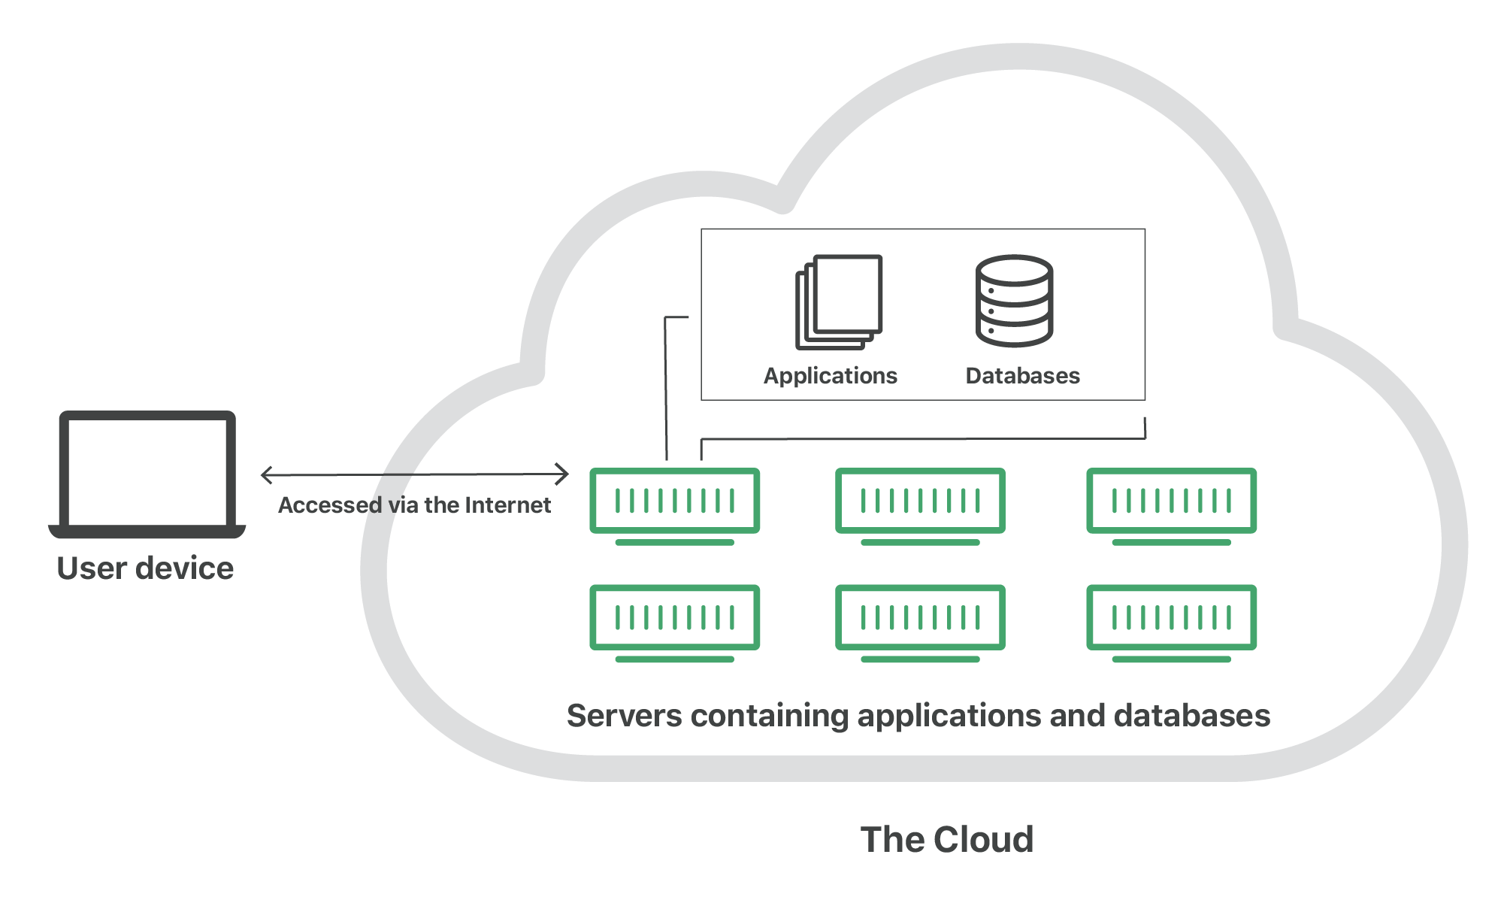
Cloud Operating System
Illustration

Slide 27


Claud OS features
Cloud computing is the delivery of different services through the Internet, including data storage, servers, databases, networking, and software.
Cloud storage has grown increasingly popular among individuals who need larger storage space and for businesses seeking an efficient off-site data back-up solution.
Cloud-based storage makes it possible to save files to a remote database and retrieve them on demand.
Services can be both public and private - public services are provided online for a fee while private services are hosted on a network to specific clients.
Cloud security has become an increasingly important field in IT.

Slide 28
Cloud Services Functions
Regardless of the kind of service, cloud computing services provide users with a series of functions including:
Email;
Storage, backup, and data retrieval;
Creating and testing apps;
Analyzing data;
Audio and video streaming;
Delivering software on demand.
Businesses can employ cloud computing in different ways. Some users maintain all apps and data on the cloud, while others use a hybrid model, keeping certain apps and data on private servers and others on the cloud.
Examples of Cloud Computing:
streaming platforms for audio or video, where the actual media files are stored remotely.
data storage platforms like Google Drive, Dropbox, OneDrive, or Box.

Slide 29
Types of Cloud Computing
Cloud computing is not a single piece of technology like a microchip or a cellphone. Rather, it's a system primarily comprised of three services:
Software-as-a-service (SaaS)
Involves the licensure of a software application to customers. Licenses are typically provided through a pay-as-you-go model or on-demand. This type of system can be found in Microsoft Office's 365.
Infrastructure-as-a-service (IaaS)
Involves a method for delivering everything from operating systems to servers and storage through IP-based connectivity as part of an on-demand service. Clients can avoid the need to purchase software or servers, and instead procure these resources in an outsourced, on-demand service. Popular examples of the IaaS system include IBM Cloud and Microsoft Azure.
Platform-as-a-service (PaaS)
Is considered the most complex of the three layers of cloud-based computing. PaaS shares some similarities with SaaS, the primary difference being that instead of delivering software online, it is actually a platform for creating software that is delivered via the Internet. This model includes platforms like Salesforce.com and Heroku.

Slide 30
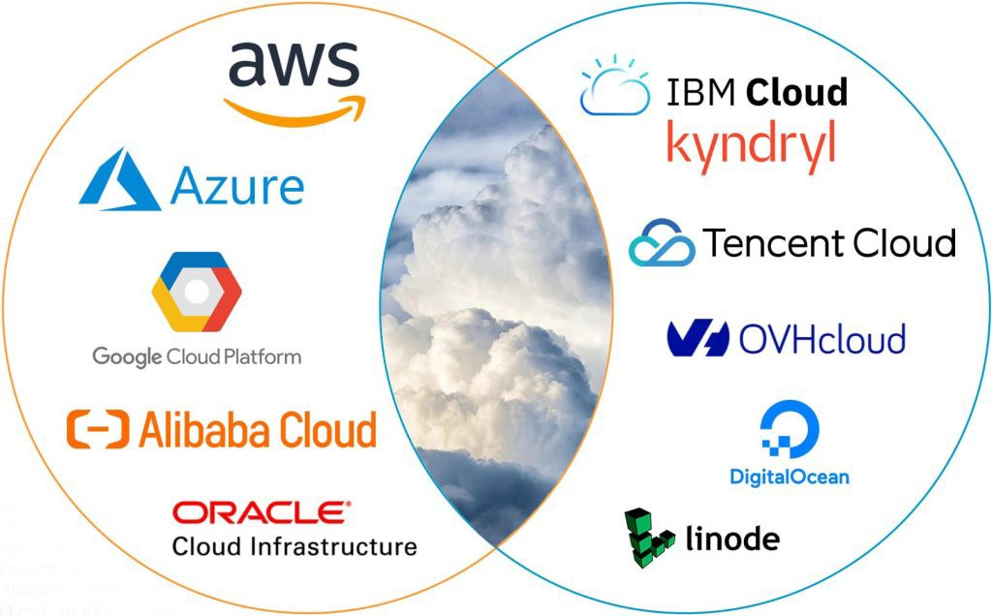
Top 10 Cloud Service Providers
As a whole, the top 10 cloud service providers globally in 2023 are:
Amazon Web Services (AWS)
Microsoft Azure
Google Cloud Platform (GCP)
Alibaba Cloud
Oracle Cloud
IBM Cloud (Kindryl)
Tencent Cloud
OVHcloud
DigitalOcean
Linode (Akamel)
Source: https://dgtlinfra.com/top-10-cloud-service-providers-2022/

Slide 31
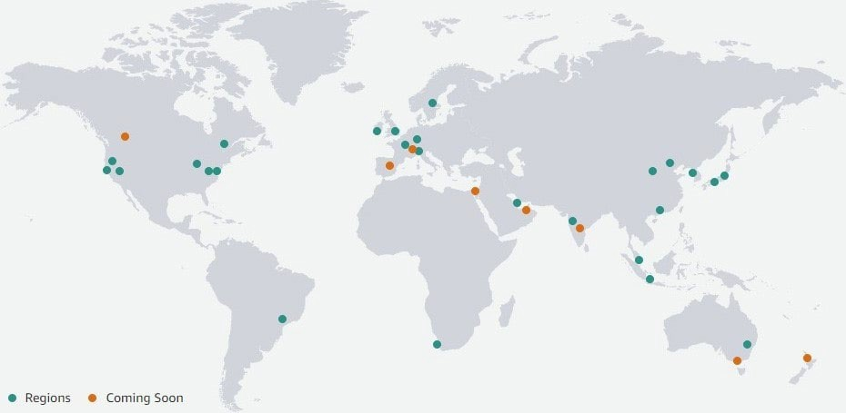
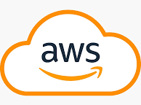
Amazon Web Services
One of the most well-liked cloud computing platforms for developing interactive online solutions for your company is Amazon Web Services (AWS). The cloud computing service of Amazon.com, is the largest cloud service provider globally. From its data centers, the business provides over 200 fully featured services including compute, storage, and database.
AWS currently has 26 regions and 84 availability zones in operation. These regions and availability zones are located throughout the United States, AWS GovCloud (US), Americas, Europe, Asia Pacific, as well as in the Middle East & Africa.

Slide 32
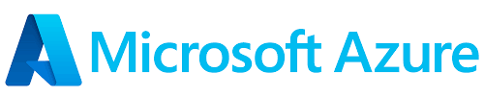
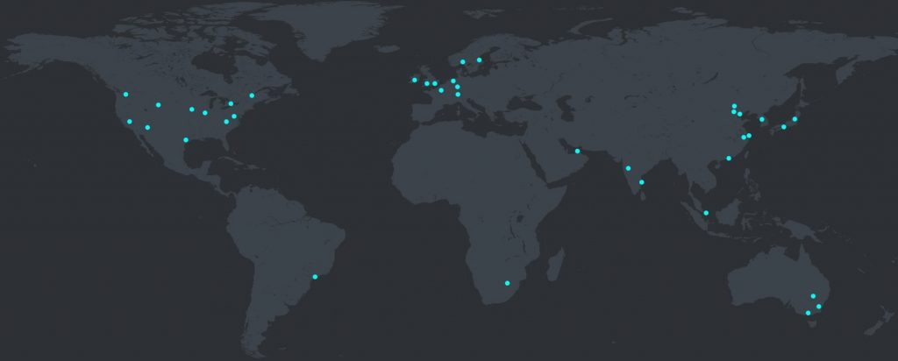
Microsoft Azure
Microsoft Corporation’s Intelligent Cloud segment contains Azure, the second largest cloud service provider globally. Through Microsoft Azure, the company delivers a consistent hybrid cloud experience, developer productivity, artificial intelligence (AI) capabilities, and security & compliance. Over 200 physical Microsoft Azure data centers are located worldwide, which house computer servers, each fitted-out with independent power, cooling, and networking. The company connects this data center infrastructure with more than 175,000 miles of fiber lines across 140 countries.

Slide 33
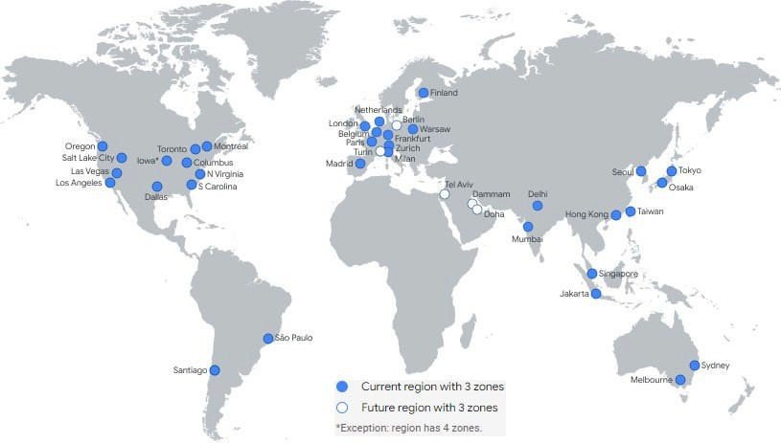
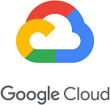
Google Cloud Platform
Google Cloud Platform (GCP), part of Alphabet Inc, is the third largest cloud service provider globally, providing enterprise-ready cloud services. GCP enables developers to build, test, and deploy applications on its distributed and scalable infrastructure, while utilizing the service’s capabilities in security, data management, analytics, and artificial intelligence (AI). Although Google Cloud may not offer as many products as Azure, it does give enough to cover all of your IaaS and PaaS needs. Usability and security are two of its primary qualities.
Google Cloud today has 34 regions and 103 availability zones in operation. These regions and availability zones are situated throughout the United States, Americas, Europe, and Asia Pacific.

Slide 34

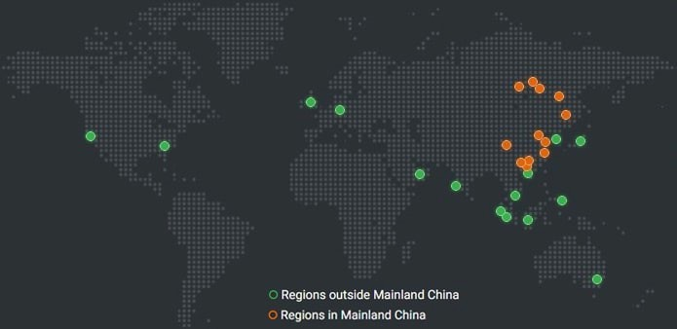
Alibaba Cloud
Alibaba Group’s cloud computing unit, known as Alibaba Cloud, is the fourth largest cloud service provider globally, the primary cloud vendor in Asia Pacific, and the largest cloud service provider in China. Through Alibaba Cloud, the business offers cloud services, including elastic computing, database, storage, network virtualization, large-scale computing, security, management & application services, big data analytics, and machine learning.
Alibaba Cloud currently has 27 regions and 84 availability zones in operation. In Mainland China, Alibaba is the dominant cloud service provider, with over 10 regions across the country. Outside of Mainland China, Alibaba Cloud operates in the United States, Europe, Asia Pacific, and the Middle East.

Slide 35
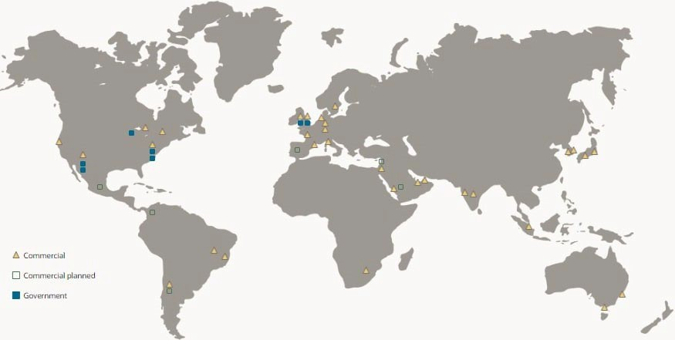
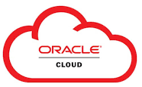
Oracle Cloud
Oracle Corporation’s Cloud Services offerings include Oracle Cloud Software-as-a-Service (SaaS) and Oracle Cloud Infrastructure (OCI). Through OCI, the company is a cloud service provider, delivering infrastructure technologies as-a-service including compute, storage, and networking services.
Oracle Cloud presently has 38 regions and 46 availability zones in operation. These regions and availability zones are located throughout the United States, Canada, Europe, the Middle East, & Africa (EMEA), Latin America, and Asia Pacific.

Slide 36
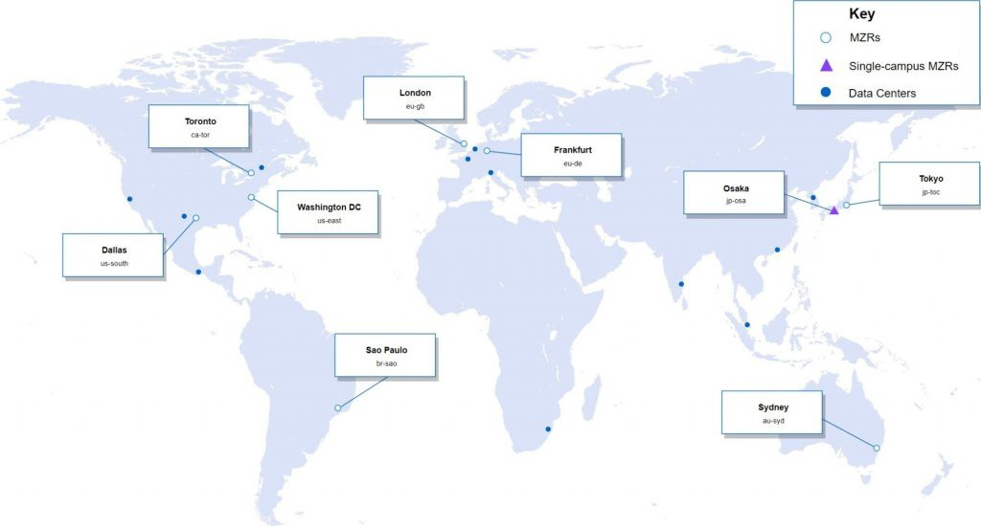

IBM Cloud
In late 2021, IBM spun-off its managed infrastructure services business to Kyndryl, which now designs, builds, and manages private, public, and multi-cloud environments for its customers.
IBM Cloud (Kyndryl) today has 11 regions and 29 availability zones in operation. These regions and availability zones are distributed throughout the United States, Americas, Europe, and Asia Pacific. Kyndryl’s Cloud Services segment helps enterprises optimize their use of cloud service providers by integrating services delivered from independent software vendors, public cloud service providers, internal platforms, and technologies such as the internet of things (IoT). To this end, Kyndryl has recently established new strategic relationships with both Microsoft Azure and Google Cloud.

Slide 37
Additional work
Explore the rest four of the top ten cloud service providers:
Tencent Cloud
OVHcloud
DigitalOcean
Linode (Akamel)
Additionally, try to find which cloud service provider has the largest market share. Present the findings in open-class discussion.

Slide 38
Advantages of Operating Systems
Resource sharing
Operating System allows for an opportunity to share resources with other users via services like printers, fax, over the network etc... some of the most commonly shared resources include: files documents, videos, images and apps, mails.
Security
With the large amount of data stored in the computers it's the responsibility of an OS to make sure all the data present is secure. A good example of an OS actively securing user data is the Microsoft's Windows Defender, it detects malicious and harmful files and removes them or denies access to install.
User friendly
Users can interact and communicate with the machine easily. The interface comes with various symbols, buttons, menus and other graphical representations which all make them easily understandable.
Multitasking
By using an operating system, users can perform different tasks simultaneously. There is no need to close one window to open another.

Slide 39
Disadvantages of Operating Systems
Cost
Unless it is an open-source operating system like Linux, most Operating Systems are considered to be expensive. Even though users can choose free versions of them, they typically have limited features.
Virus attacks
Just like any other software out there, the risk of viruses is always higher in an operating system. Sometimes users can unknowingly download malicious programs, visit malicious websites, or open email attachments containing viruses, all which can make a computer vulnerable to viruses.
Complexity
The languages used to develop the OS are more complex for people without programming knowledge. So you can't always quickly resolve problems in the OS just by looking you will have to look for a specialist to help hence maintenance cost rises.
System failure
An operating system is the heart of the computer system, and if by any chance, due to any reason, it stops functioning, then the whole system will crash. Meaning without an OS your machine can not function at all.

Slide 40


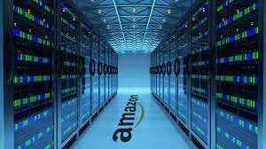
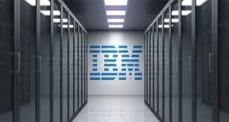
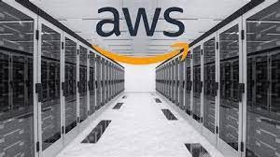

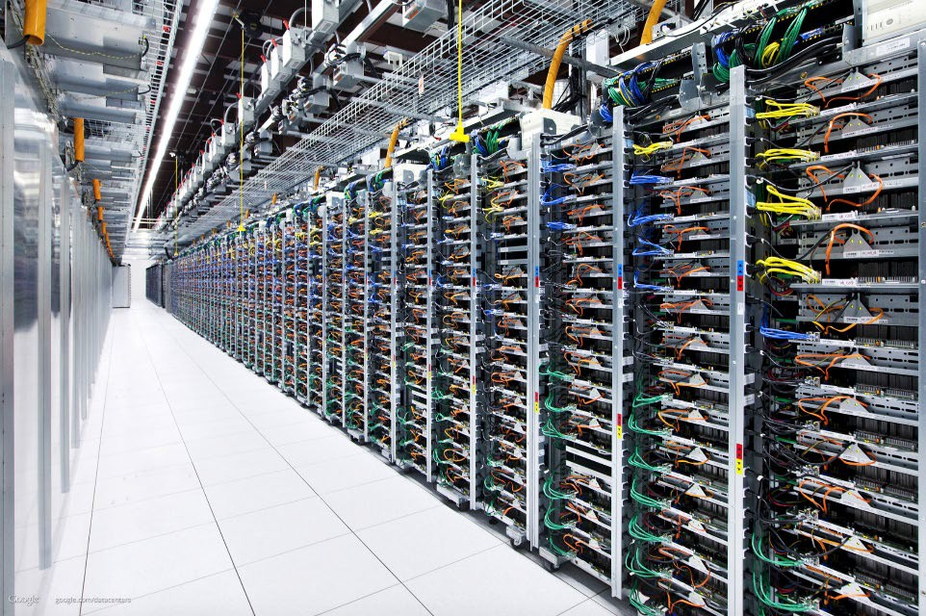

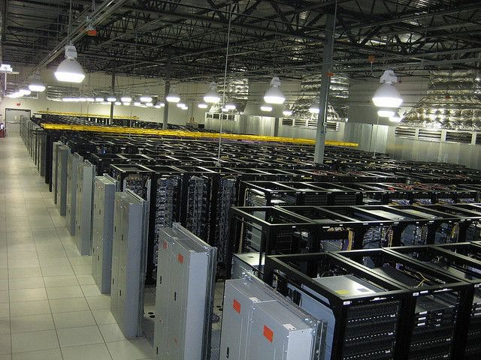
Inside Data Centеrs

Slide 41
Quick “In class Mock test”
The two main types of software are Application software and .......
System software
Transaction software
Strategic software
Embedded software

Slide 42
Quick “In class Mock test”
Which type of software manages the computer's processes, functioning as an interface, connecting the user, the application software, and the hardware?
System software
Operating system
Utility program
Translator program

Slide 43
Quick “In class Mock test”
Two or more computers connected to each other of sharing information form a
server
router
network
VPN

Slide 44
Useful links
https://www.youtube.com/watch?v=q6WlzHLxNKI Inside Amazon's Massive Data Center
https://www.youtube.com/watch?v=0_veMXUsutU Why does Microsoft have underwater data centers?

Slide 45
Thank you for your attention!

